Slide 1

GyanFit
“Unlocking healthier lives through technology”

Slide 2
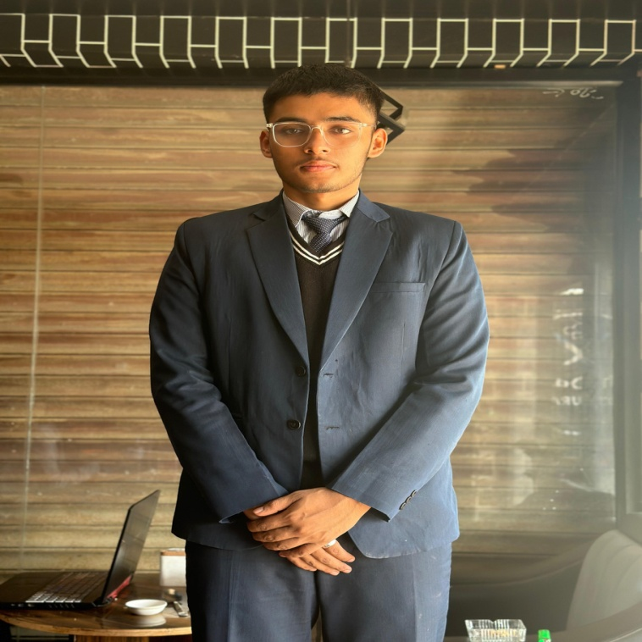
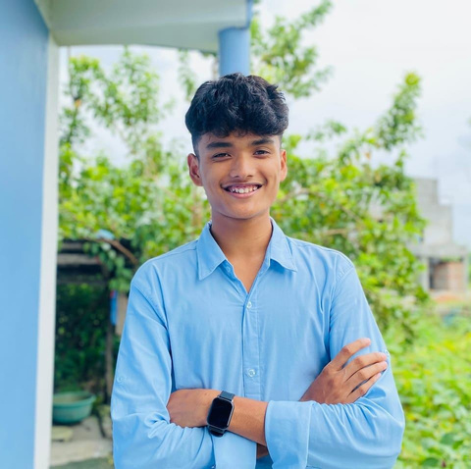
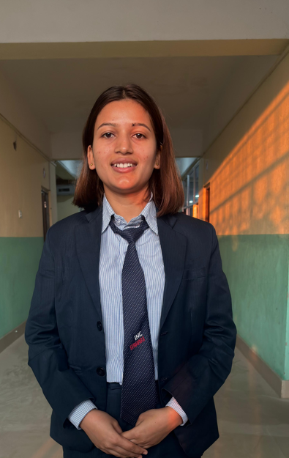
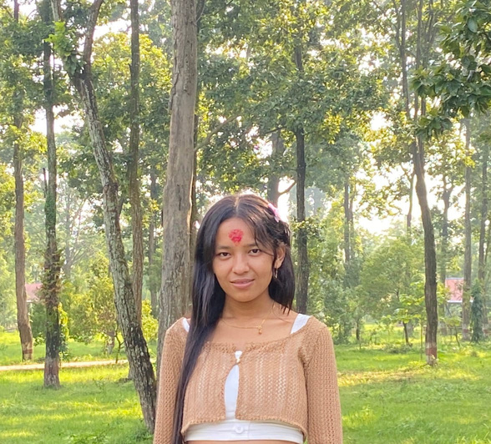
Team Members
Prashanga Pokharel
Rupesh Chaudhary
Preksha Acharya
Barsha Magar
Backend
Frontend
Backend
Frontend

Slide 3
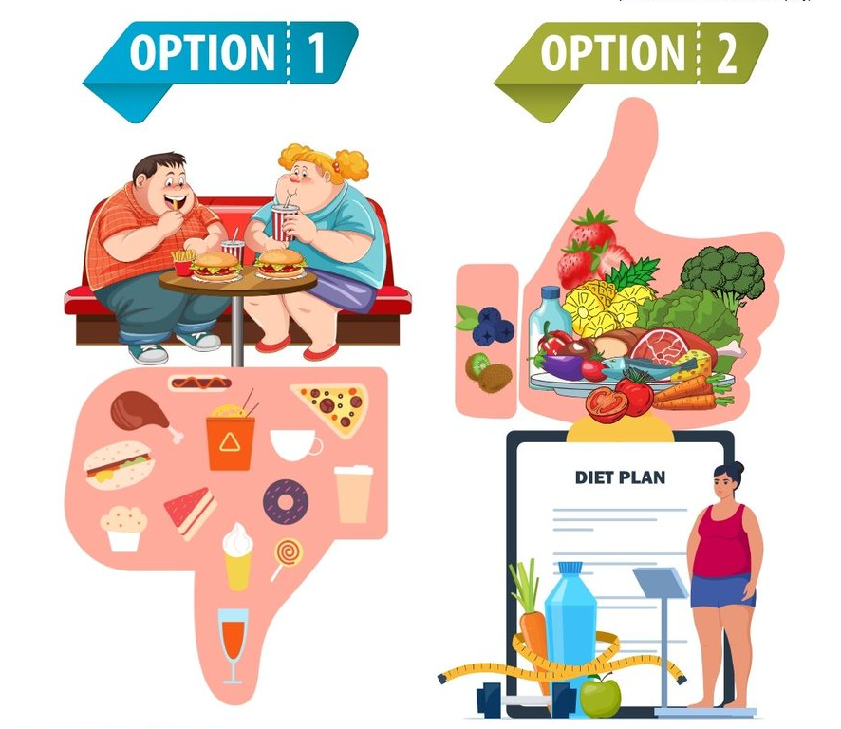
PROBLEM ADDRESSING
Lack of personalized Dietary Guidance.
Difficulty Maintaining a Healthy personal and social Life.

Slide 4
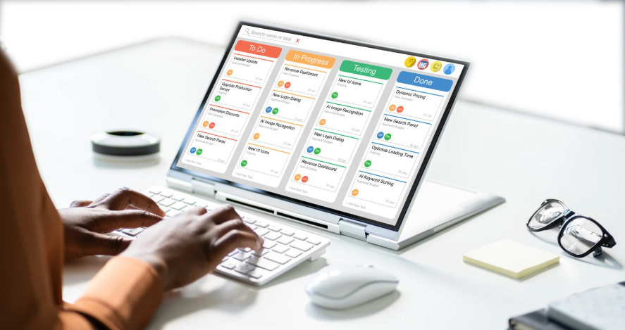
USER SOLUTION
1. Automated daily activity scheduling.

Slide 5
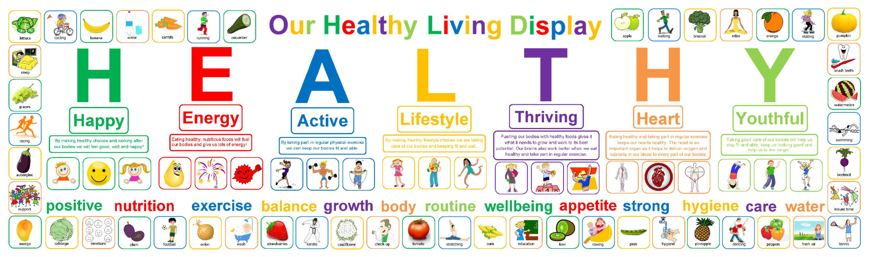
USER SOLUTION
2. Healthy lifestyle adaptation.

Slide 6
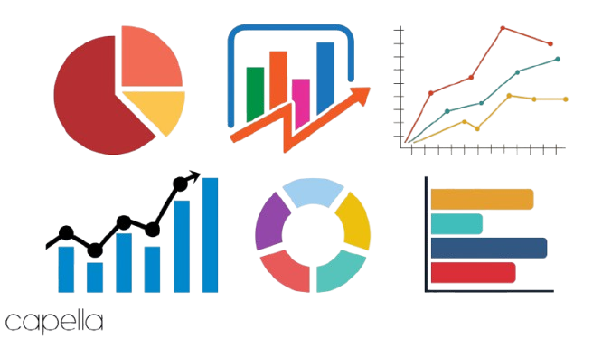
USER SOLUTION
3. Health data analytics and feedback.

Slide 7

SOCIAL SOLUTION
Encourages Community engagement.

Slide 8

UNIQUE FEATURES
Nepali food store datatbase
Consist of nepali food and its data
SMS
After the completion of daily goal the SMS is sent.
AI
Scanner

Slide 9

BUSINESS MODEL
Freemium Model
Limited free features (premium/Subscription)
User Report Generation
Future Reference
Data Sales
i.e Nepali Restaurent, survey, Research.

Slide 10
FREE
PREMIUM
Analytics
Ai suggestion
Barcode
1000+ Nutrition
SMS Alert
SMS Alert
Workout

Slide 11
PROJECT DEMONSTRATION

Slide 12





Thank you for your attention

